Slide 1

Introduction to Linear Regression
Understanding how machines learn to predict continuous values through one of the most fundamental algorithms in machine learning
Dr. Zainab Malik | zainabmalik@um.edu.my

Slide 2
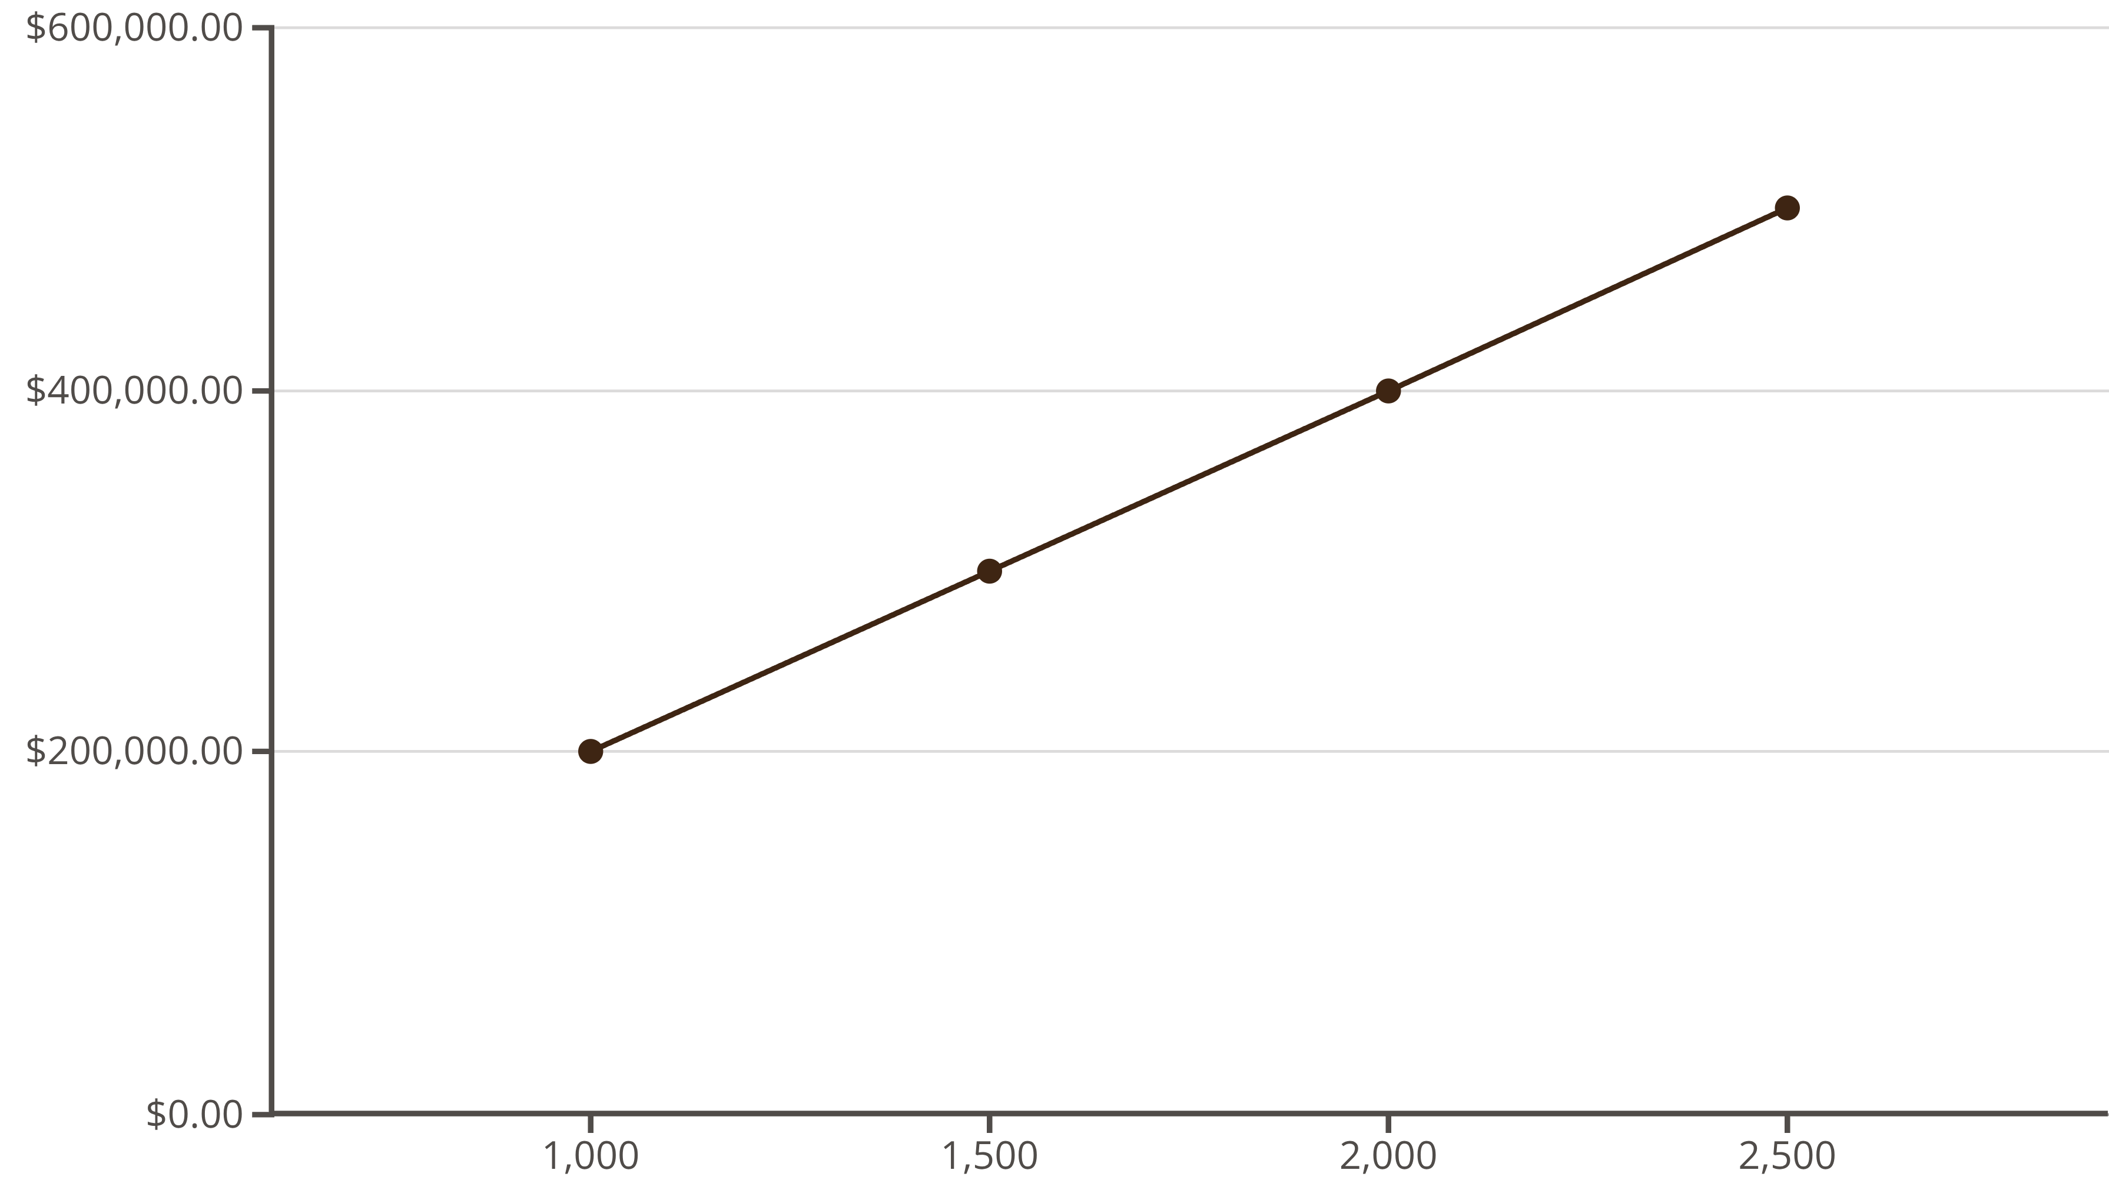
A Simple Example to Start
Imagine you're looking at houses for sale and notice a clear pattern: larger houses consistently cost more money. This observation raises an interesting question—can we predict the price of any house if we simply know its size?
Notice the pattern? The relationship is remarkably consistent: Price ≈ Size × 200. This simple observation is the foundation of linear regression.

Slide 3

What is Linear Regression?
A supervised learning algorithm used to predict a continuous numerical value by finding the best-fitting straight line through data points.
Independent Variable (x)
Dependent Variable (y)
The Goal
What we know and use as input—like the size of a house in square feet
What we want to predict as output—like the price of that house
Find the straight line that minimizes the difference between predictions and actual values

Slide 4
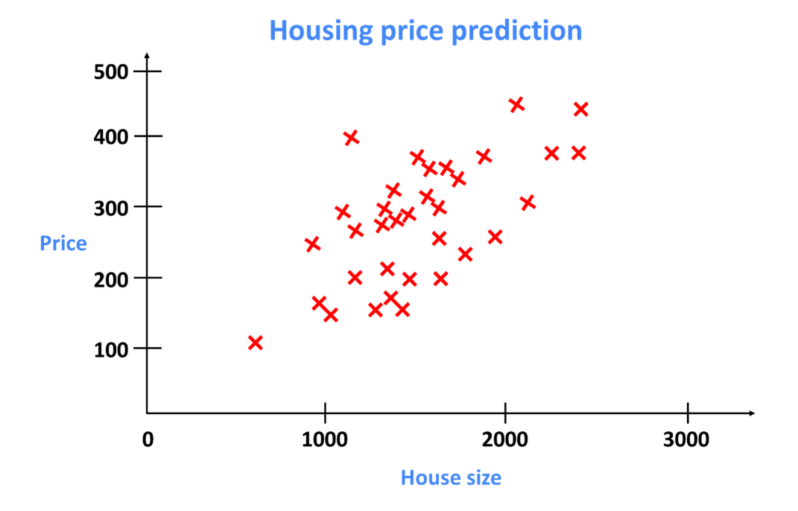

Slide 5
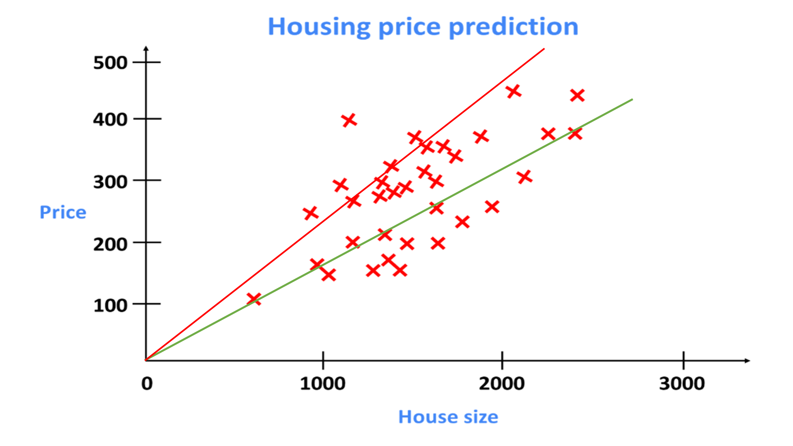
Visualizing the "Best Fit" Line
Actual Data Points
Poor Fit Line
Best Fit Line
Red cross represent real observations—each showing an actual house size paired with its true sale price
The red line misses many points by large distances, creating significant prediction errors
The green line comes closest to all points on average, minimizing the total error across all predictions
The key question: How do we mathematically find the "best" line? We measure errors and choose the line that makes those errors as small as possible!

Slide 8
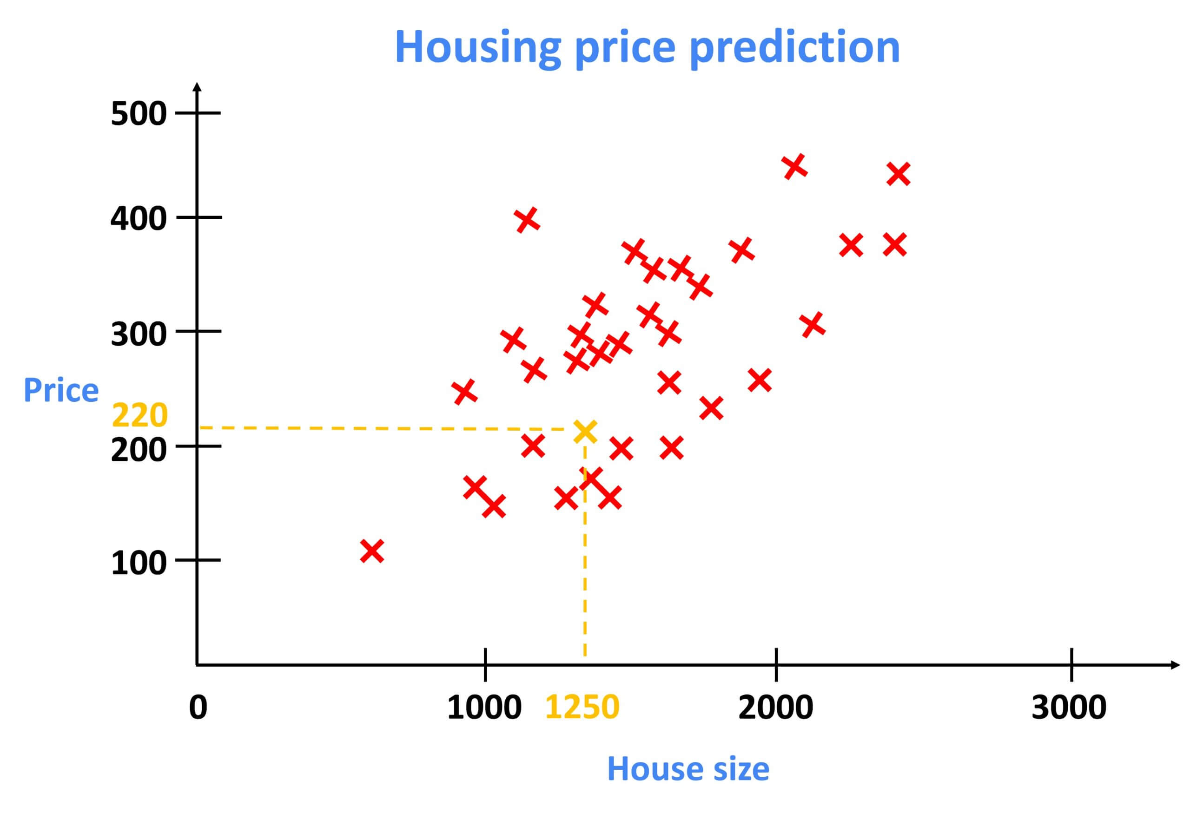

Slide 9
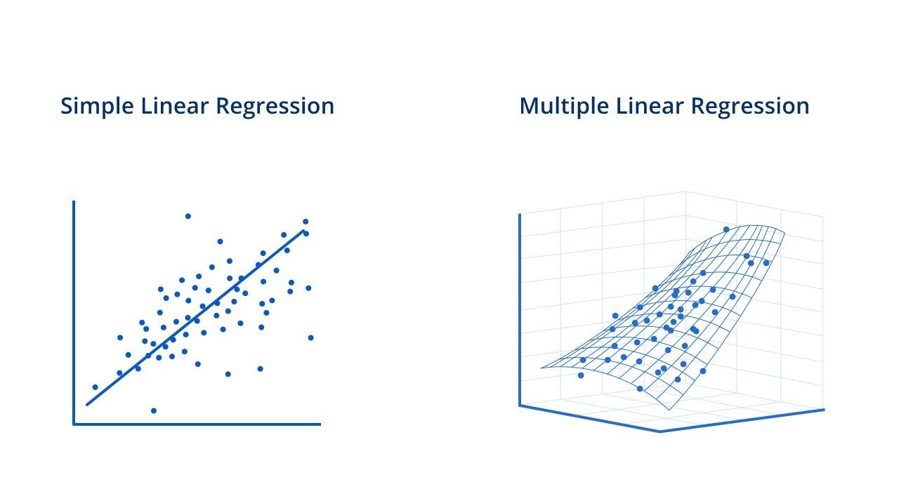

Slide 11

The Equation of a Line
Remember from school?
In machine learning terms
y: Dependent variable (output/price)
ŷ (y-hat): Predicted value
x: Independent variable (input/size)
w₁: Weight (same as slope)
m: Slope (how much y changes when x increases)
w₀: Bias (same as intercept)
c: Intercept (value of y when x = 0)
Example: Predicted Price = (slope × Size) + intercept

Slide 12
How to Find the Best Line?
01
02
Ordinary Least Squares (OLS)
Gradient Descent (GD)
exact solution
Finds line that minimizes sum of squared errors
Pros: Fast, exact solution
Cons: Doesn’t scale well for huge data
iterative approach
Start with random line, slowly improve it
Like walking down a hill to find lowest valley
Valley = lowest error (cost)
Use OLS: Small datasets, need exact solution, interpretability
Use GD: Large datasets, online learning, neural networks later

Slide 13
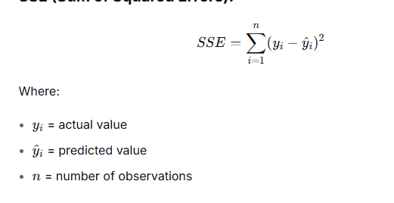
Cost Function: Sum of Squared Error (SSE)

Slide 14

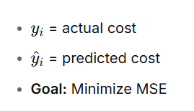
Cost Function: Mean Squared Error (MSE)

Slide 15
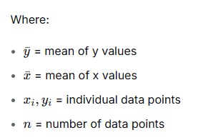


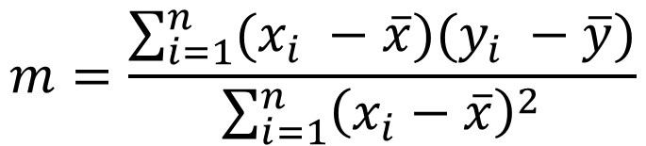
Ordinary Least Square Method
$$y=mx+c$$
$$m=\frac{\sum_{i=1}^{n}{(x_{i} −\overline{x})(y_{i} −\overline{y})}}{\sum_{i=1}^{n}{{\left(x_{i}−\overline{x}\right)}^{2}}}$$
$$c=\overline{y} −m \overline{x}$$

Slide 16

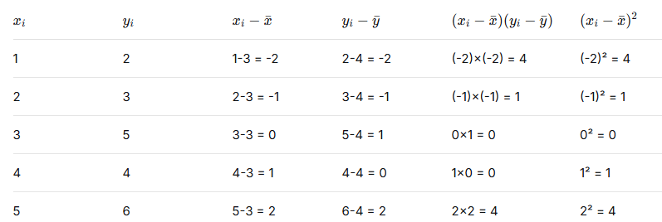
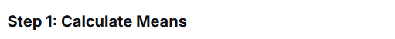
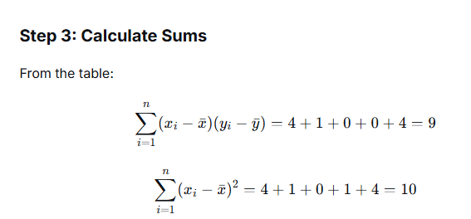
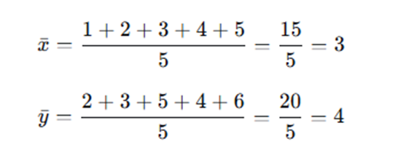
Ordinary Least Square Method
xi​ | yi
1 | 2
2 | 3
3 | 5
4 | 4
5 | 6

Slide 17
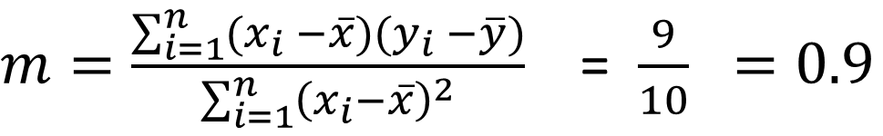
Ordinary Least Square Method
Step 5 : Calculate Slope
$m=\frac{\sum_{i=1}^{n}{(x_{i} −\overline{x})(y_{i} −\overline{y})}}{\sum_{i=1}^{n}{{\left(x_{i}−\overline{x}\right)}^{2}}}$ = $\frac{9}{10} =0.9$
Step 6 : Calculate Intercept
$$c=\overline{y} −m \overline{x} = 4−0.9 ∗3=4−2.7=1.3$$
Step 6: Final Regression Line
$$y=mx+c =1.3+0.9 x$$

Slide 18
Ordinary Least Square Method
Key insight: OLS finds the line that minimizes vertical distances (squared) between points and the line. Your formulas give the exact mathematical solution to that minimization problem

Slide 19
How to Find the Best Line?
01
02
Ordinary Least Squares (OLS)
Gradient Descent (GD)
exact solution
Finds line that minimizes sum of squared errors
Pros: Fast, exact solution
Cons: Doesn’t scale well for huge data
iterative approach
Start with random line, slowly improve it
Like walking down a hill to find lowest valley
Valley = lowest error (cost)
Use OLS: Small datasets, need exact solution, interpretability
Use GD: Large datasets, online learning, neural networks later

Slide 20
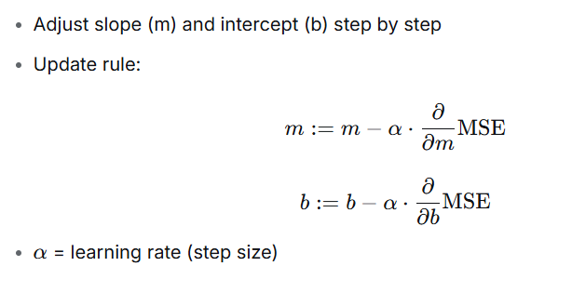
Gradient Descent: The Update Rule

Slide 21
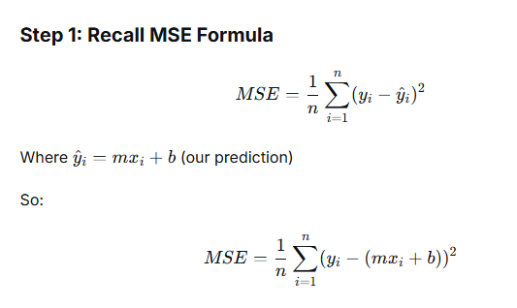
Gradient Descent: The Update Rule

Slide 22
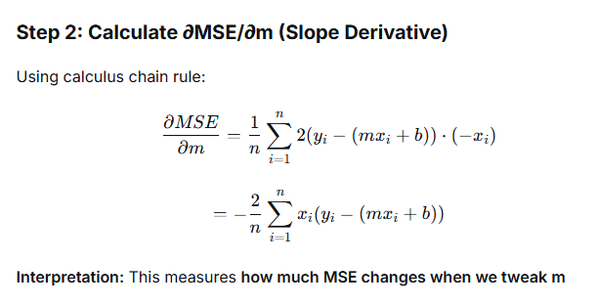
Gradient Descent: The Update Rule

Slide 23
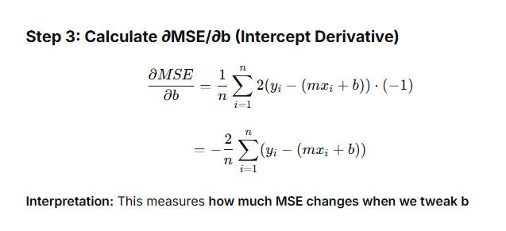
Gradient Descent: The Update Rule

Slide 24
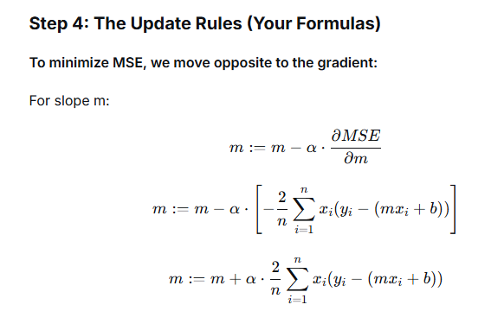
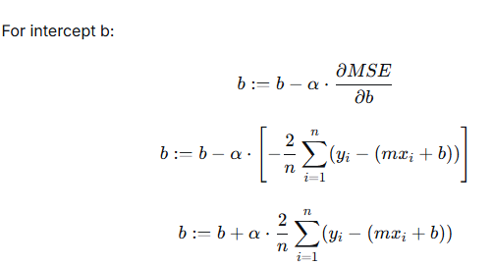
Gradient Descent: The Update Rule

Slide 25
Gradient Descent: The Update Rule

Slide 26
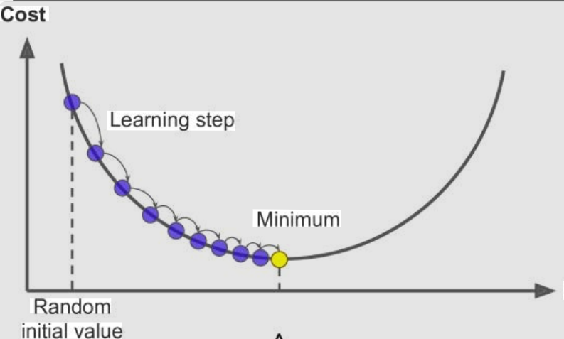
Gradient Descent Visualization
Start with bad line
Compute slope of cost function
Move in downhill direction
Repeat until minimum

Slide 27

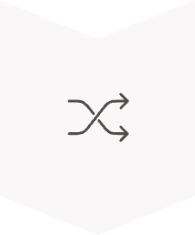



How the Computer Finds the Best Line
Gradient Descent: The Intuition
Start with Random Values
Initialize slope (w₁) and intercept (w₀) with random numbers
Calculate the MSE
Measure how poorly our current line performs with these values
Adjust Parameters
Tweak w₁ and w₀ slightly in the direction that reduces the MSE
Repeat Until Convergence
Continue adjusting until MSE stops improving significantly
Helpful Analogy: Imagine walking down a foggy hill blindfolded, taking small careful steps and feeling the ground beneath you, always moving toward the lowest point you can find.

Slide 28
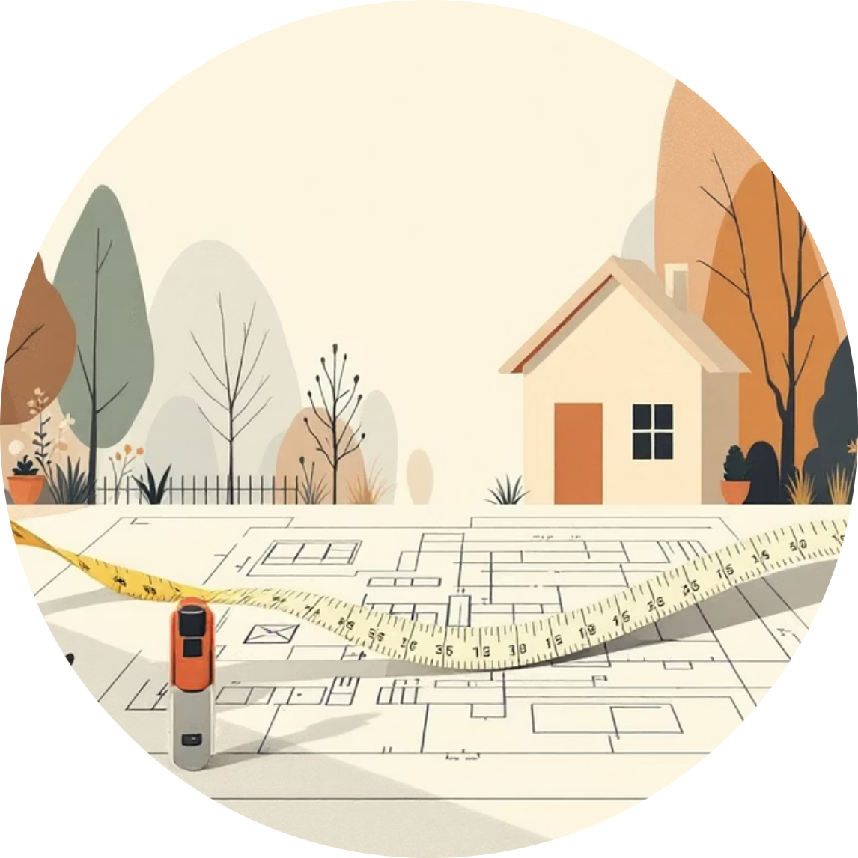


Real-World Example: Beyond Just Size
In reality, house prices depend on more than just square footage. Multiple Linear Regression allows us to incorporate several features simultaneously.
Size Weight (w₁)
Bedroom Weight (w₂)
Age Weight (w₃)
How much each additional square foot adds to the predicted price
The value contribution of each additional bedroom to the total price
Impact of building age—could be negative if older homes are worth less
Key insight: The equation is still linear—we're just working in more dimensions! Each feature gets its own weight that contributes to the final prediction.

Slide 29
Summary
Key Takeaways:
Linear regression predicts continuous values
Finds the best-fitting line: ŷ = w₁x + w₀
Minimizes Mean Squared Error (MSE)
Can handle multiple input features

Slide 30
Thank You

